Slide 1
SME Instrument evalvacija
Miomir Knežević,
Educell d.o.o.
Medical Biobank Swiss Institute AG

Slide 2
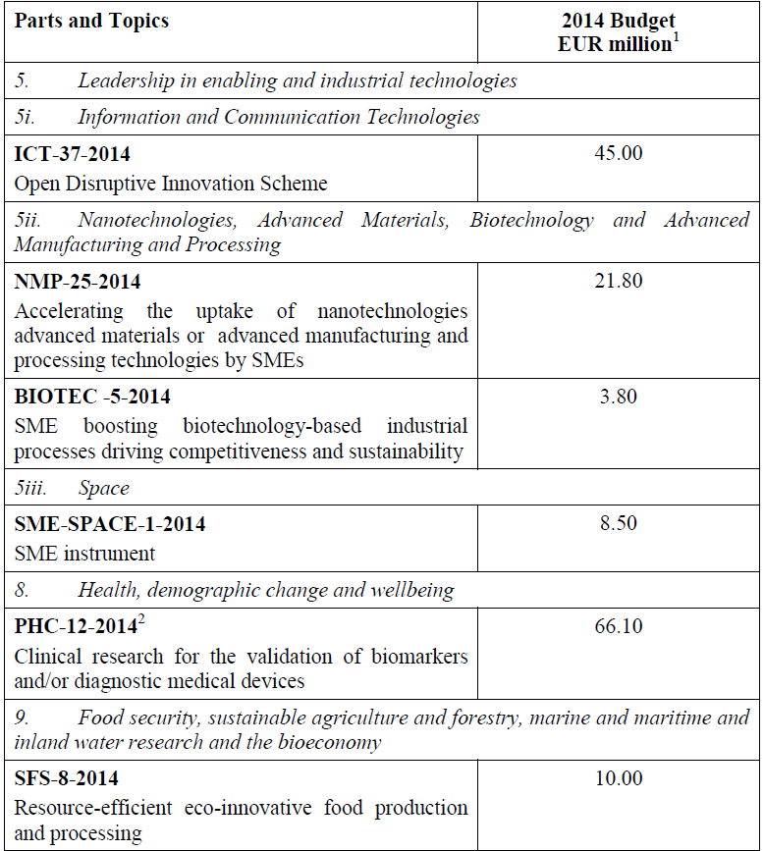

Slide 3
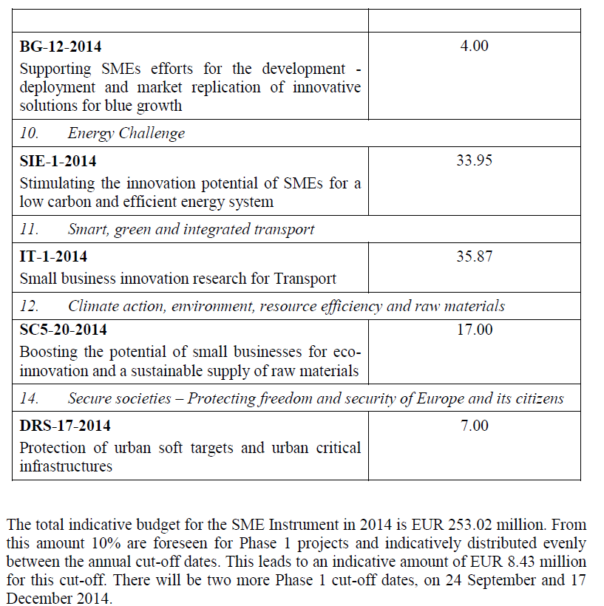

Slide 4
The distribution of projects per topic and the corresponding budgets
. Budget in EUR Projects to be funded
BG-12 150,000 3
Biotech 150,000 3
IT-1 1,300,000 26
NMP 850,000 17
SC-5 600,000 12
SFS-8 350,000 7
SIE-1 1,150,000 23
SPACE 200,000 4
DRS-17 300,000 6
PHC-12 1,200,000 24
ODI 1,500,000 30
TOTAL 7,750,000 155

Slide 5
Rezultati
Projects submitted Projects funded
2662 155

Slide 6
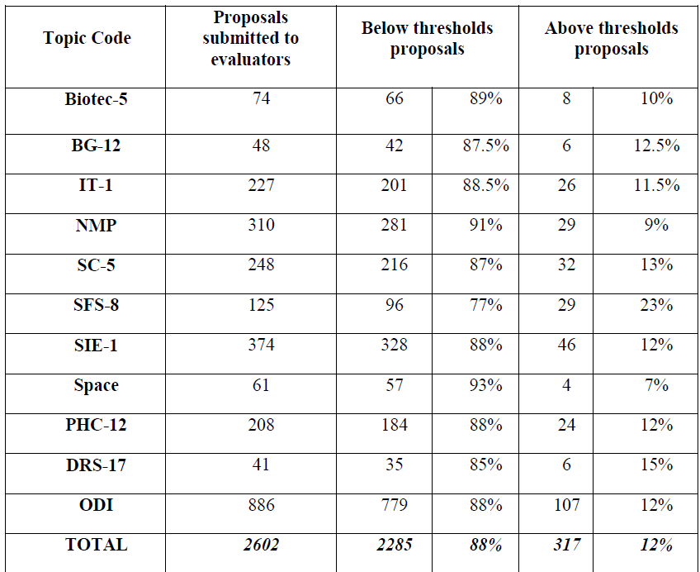

Slide 7
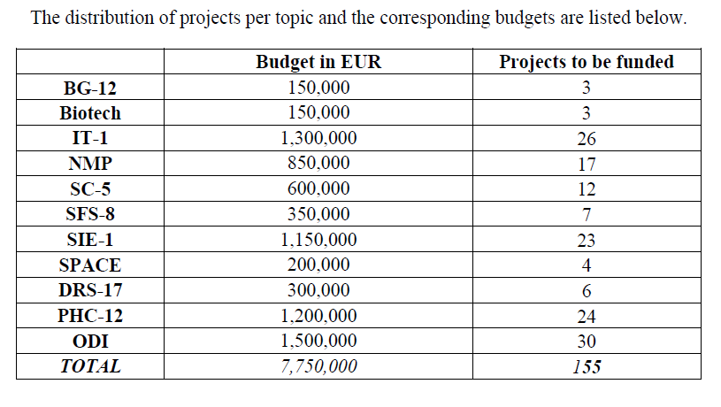

Slide 8
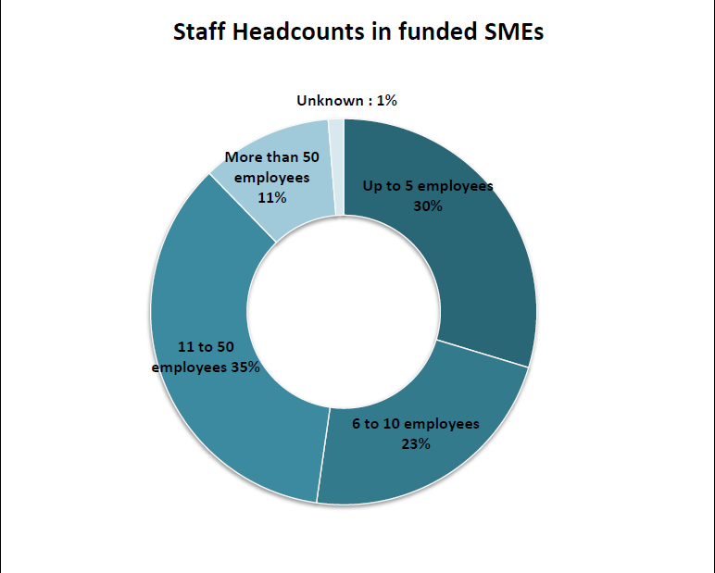

Slide 9
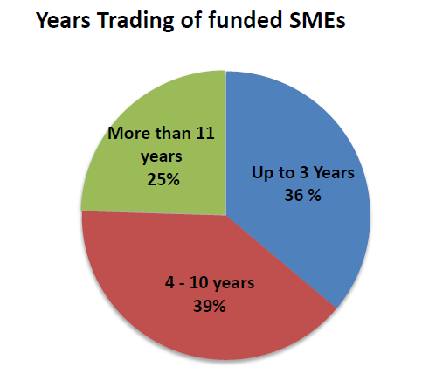
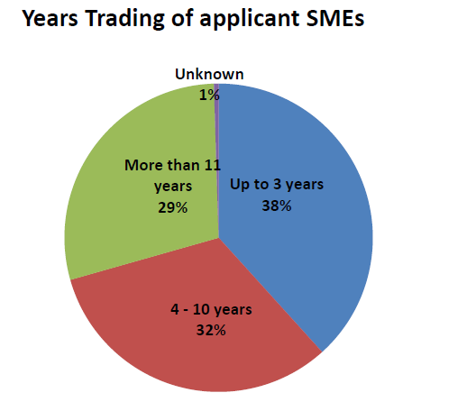
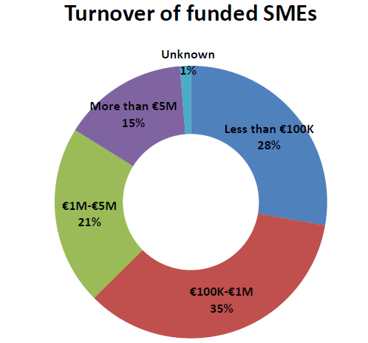
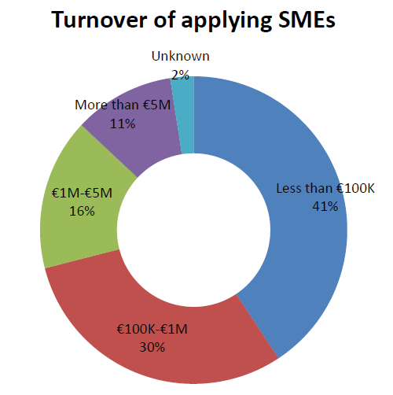

Slide 12
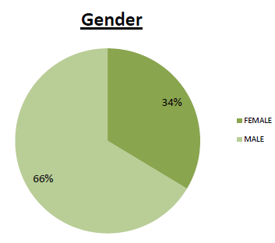
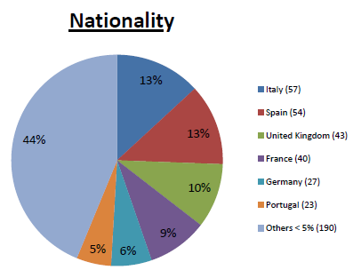
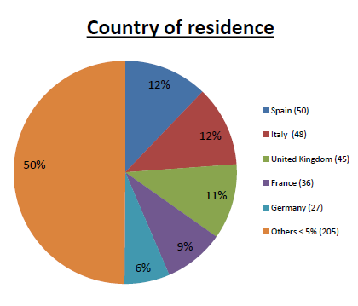
Statistical information on evaluators

Slide 13
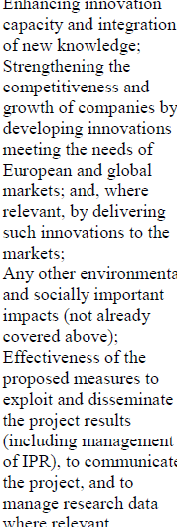
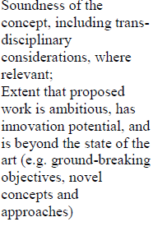
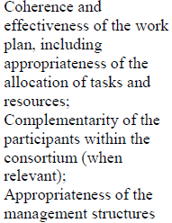

Slide 14
